Slide 1


COMP507 IT Project Management Stakeholder Management Daniel Vaipulu

Slide 2
Assignment 1 – Part 1
Use the following information
Discount Rate– 8%
Background information- talk about BCIS qualification as a strategic offering by ECMS- the largest number of students. R&D paper-final two-semester paper, part of all BCIS majors, students do industry-based projects. Students gain valuable industry experience which enables them to get an IT role.
School’s business objective is to achieve a growth of 3 to 5% growth in BCIS intake. Provide industry-based teaching (quality education)- choice for a PMS for BCIS students rather than just MS Project.

Slide 3
Learning Objectives
Understand the importance of project stakeholder management
Discuss the process of identifying stakeholders- how to create a stakeholder register, how to perform a stakeholder analysis and create a stakeholder strategy management document
Understand how to develop a Stakeholder register, Stakeholder management strategy, risk register, Issue management, and financial analysis.

Slide 4
Importance of Project Stakeholder Management
Because stakeholder management is so important to project success, the Project Management Institute decided to create an entire knowledge area devoted to it as part of the Fifth Edition of the PMBOK® Guide in 2012
The purpose of project stakeholder management
is to identify all stakeholders (people/organizations),
learn their expectations,
identify the critical ones and effectively engage with them

Slide 5
Importance of Project Stakeholder Management
Need to identify all the stakeholders of the project, captured in the stakeholder register.
The template used to capture stakeholder details must be comprehensive. Usually need to have the name, position, stakeholder type (category), project role, and contact detail. Adapt to suit your requirements
Two categories-
Internal stakeholders- individuals within the organization; the project team members including any other individual interested in the project (passive stakeholders)
External Stakeholders- outside the organization, suppliers, consultants, contractors, etc. who also contribute to the project

Slide 6
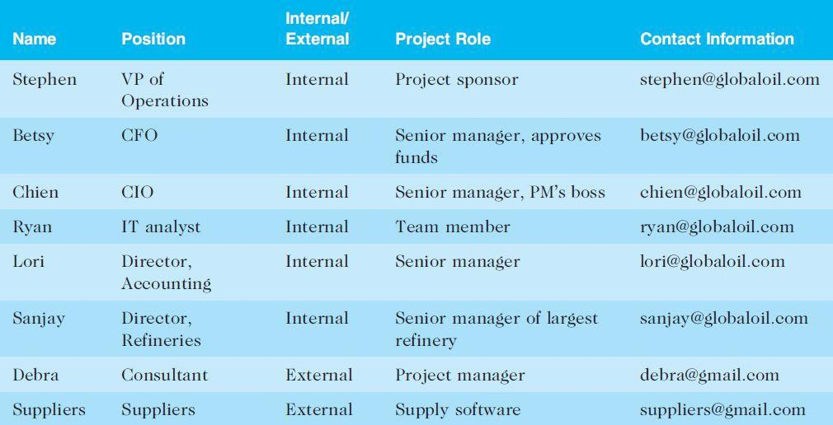
Table 13-1. Sample Stakeholder Register

Slide 7
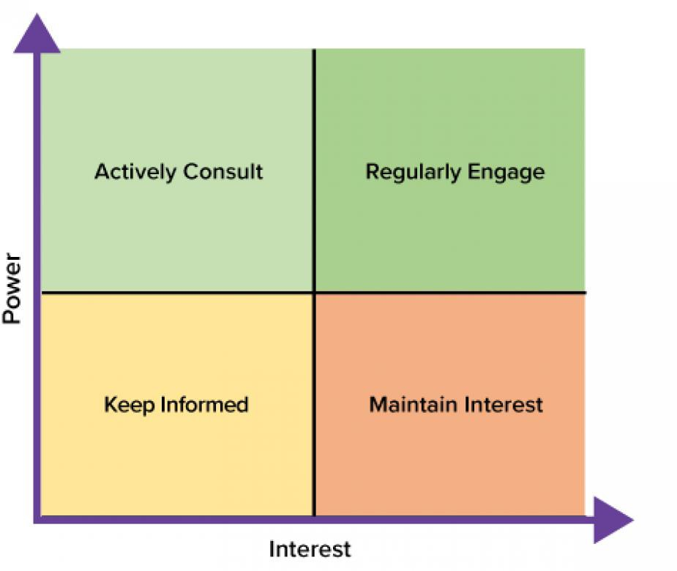
Stakeholder analysis
Done to:
Learn their project expectations
Identify the critical ones to manage them effectively
Complete a power-interest grid to identify and accordingly manage their expectation

Slide 8
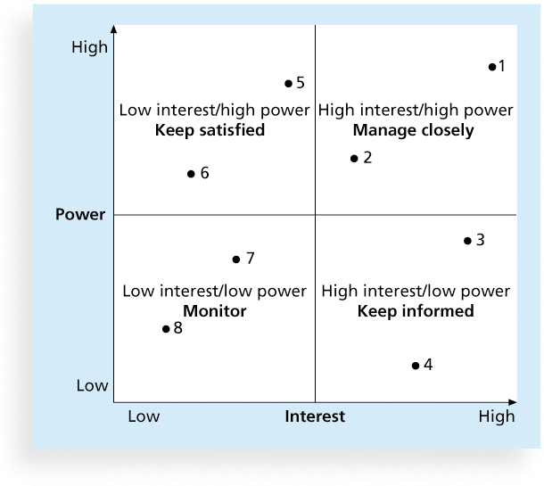
Figure 13-2. Power-Interest Grid

Slide 9
Stakeholder Engagement Levels
Unaware: Unaware of the project and its potential impact on them
Resistant: Aware of the project yet resistant to change
Neutral: Aware of the project yet neither supportive nor resistant
Supportive: Aware of the project and supportive of change
Leading: Aware of the project

Slide 10
Activity One Stakeholder analysis
AUT’s ICT Service Desk receives a high volume of student queries regarding password resets, MFA issues, Wi-Fi access, software installations, and Canvas access. Students currently use email, phone, and walk-in support, but response times vary, and the same questions keep coming up. The Service Desk Manager wants a prototype “MyAUT Support Hub” that provides a simple self-service portal with FAQs, step-by-step guides, and a ticket submission form that routes requests to the right support queue. The portal must be easy for students to use, must not expose personal data, and must fit within AUT’s approved tools. The prototype will be tested with a small group of students and staff before any production decision is made.
Task
Who are the key stakeholders?
Based on the case study, how should the key stakeholders be categorised into Actively Consult, Regularly Engage, Keep Informed, and Monitor/Maintain Interest, and why?

Slide 11
Planning Stakeholder Management
After identifying and analyzing stakeholders, project teams should develop a plan to manage them
The stakeholder management plan can include:
Potential management strategies for each stakeholders
Communication requirements
Expectations Management Matrix

Slide 12
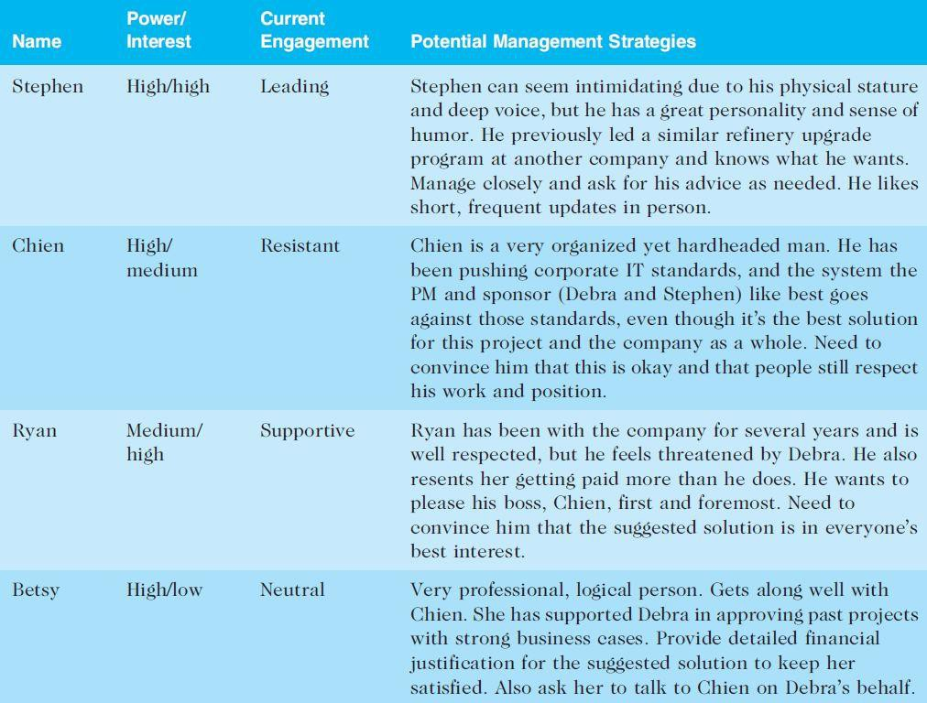
Table 13-2. Stakeholder Management Plan

Slide 13
Managing Stakeholder Engagement
Project success can often be measured in terms of customer and sponsor satisfaction
Project sponsors often rank scope, time, and cost goals in order of importance and provide guidelines on how to balance the triple constraint
This ranking can be shown in an expectations management matrix to help clarify expectations

Slide 14
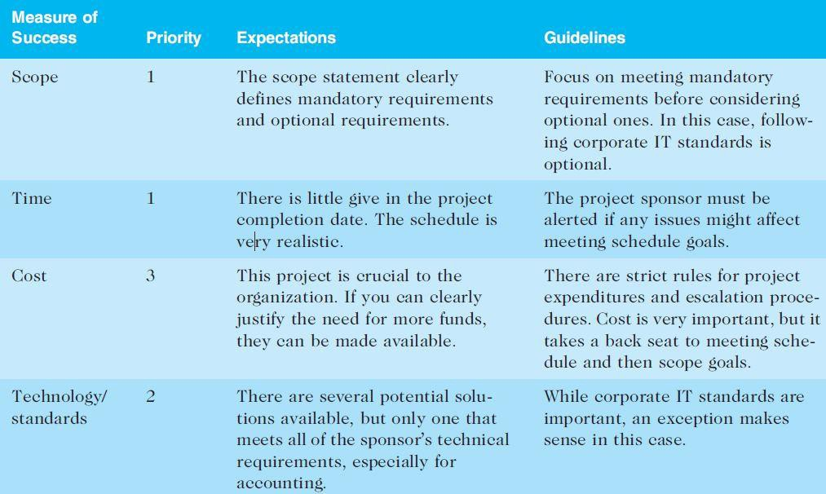
Expectations Management Matrix (useful)

Slide 15
Managing issues
Need an issue management plan
Clearly identify procedures-
- how an issue will be captured (need an Issue log) and addressed (bullet point steps involved to deal with an issue such as issue assignment, resolution timeframe, M/C & Closure )
Must deal with issues of all stakeholders – including the client, sponsor, and team
Issues should be captured in an issue log- a tool used to document, monitor, and track issues that need resolution- an Excel SS template (tool) is provided for issue management.
Unresolved issues will result in stakeholder expectations not being met
issues if not dealt with in a timely manner will become a risk – and impact the scope, schedule, and budget

Slide 16
Risks vs Issues
Issues are encountered when project tasks (work task done as a part of a phase) are being undertaken.
It stops an individual from working on the assigned task (due to a lack of understanding, experience, knowledge, or skills, etc.) until it is resolved.
Risks are identified and captured before the project starts, including strategies identified to prevent risks from emerging during the project. Must M/C risks throughout the project lifecycle and will also help to identify any emerging risks in the project.
A ‘risk’ may or may not happen, but if it does, It will have a major impact on the project (negatively).
Risks can be predicted (based on experience) whereas issues can’t be predicted before the project starts.
Note- both, risks and issues enable learning and gaining project experience (emotional maturity).
Sankararajan, D. & Shrivastava, N. K. (2012). Risks vs. issues. PM Network, 26(6), 28–29.

Slide 17
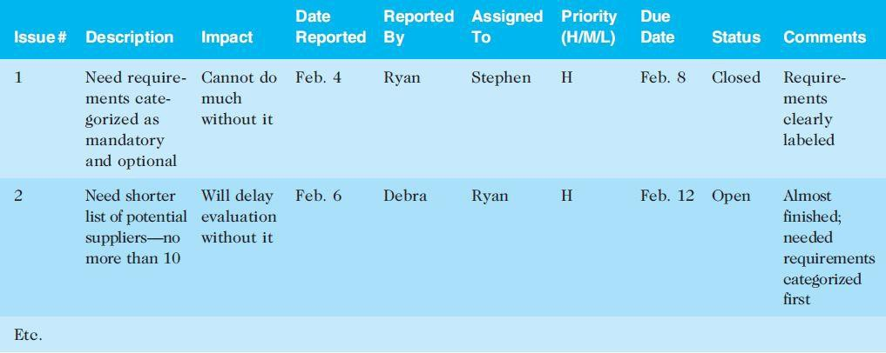
Table 13-4. Sample Issue Log

Slide 18
Procedure for issue management for assignment 1
-The issue log must be accessible to all stakeholders (online)
- After logging an issue, the individual (stakeholder) must immediately email to notify the team leader
-The team leader will decide in consultation with the individual (who logged the issue) how the issue must be resolved. Based on the decision, the issue register must be updated with the necessary information by the team leader.
-Once resolved, the issue log must be updated to close the issue
-Any issue logged must be dealt with within a 5 working day period (team decides this rule) to avoid an impact on the schedule. If not, it must be logged in the risk register and a team meeting must be called to discuss it to decide upon appropriate strategies to minimize the impact.
-An issue not resolved must be escalated to the lecturer as a risk to the project
Note- for assignments, issues will mostly be logged by the team members. For the R&D project, you may also have client logging issues in your Team’s issue register

Slide 19
Issue Log- wiki Project
Issue # | Issue Description | Impact on Project | Date Reported | Reported By | Assigned To | Priority(M/H/L) | Due Date | Status | Comments
1 | Business case- A discount rate not provided | Will not be able to do a reliable financial calculation for Business Case impacting our 1st deliverable | 1/08/2023 | James | Julia (Team Leader ) to email/talk with client (TA) | H | 2/08/2023 | Closed | The client(TA) emailed the Team leader to inform her that the discount rate is 8%
2 | Business case- need background information on BCIS qualification to write up introduction/background section | Will not be able to make a sound Business case for the project | 3/08/2023 | John | Julia (Team Leader ) to organize a time for the entire team to be co-located and do web (AUT & Department)research to gather the necessary information | H | 8/08/2023 | Open
3 | Business case- need to identify Business objectives | Will not be able to make a sound Business case for the project | 3/08/2023 | John | Julia (Team Leader ) to organize a meeting with the client (lecturer)to find out the business objective of the school regarding BCIS qualification | H | 8/08/2023 | Open

Slide 20
Monitoring and Controlling Stakeholder Engagement
Must M/C the level of engagement of the stakeholders
Must have team meetings, show and tell achievements. An important element for assignment 1 (COMP507)
Must have client meetings to consult and provide status reports and get feedback- An important element for the R&D project Paper (COMP702 & COMP703) including the team meetings for the purpose stated above.

Slide 21
Activity Three: Issue management
AUT Library wants a prototype online study room booking system to replace the current paper sign-up sheet and ad hoc email requests. Students are frustrated because they often arrive expecting a room and discover someone else is already in it, and staff spend time resolving disputes and checking emails. The library agreed to trial a prototype to see whether a digital booking process would reduce double-bookings and improve visibility of room availability. After the proposal was approved, the team began delivering work in Week 7. By Week 8, the team has identified several problems that need to be captured as issues (things already happening). First, Jordan (team leader) has been unable to confirm final scope decisions because the library contact has been difficult to lock in. Jordan needs a confirmed meeting schedule within the next 48 hours so requirements can be agreed upon and the team can stop guessing. Second, Malia (tech lead) still does not have access to the approved hosting environment; without it, the team cannot deploy a live version for proper testing and review. Malia is expected to get access confirmed by Wednesday, 5:00 pm. Third, during an early trial session, David (UX lead) observed that students hesitated and asked for help because the booking screen was not clear about which rooms and time slots were available. David must run another student trial after improving the screen by Friday, 3:00 pm. Finally, Ava (developer) found a booking outcome that should not be possible: when two booking requests are submitted close together, the same room/time can end up booked more than once. Ava must investigate, fix, and re-test this behaviour by Thursday, 4:00 pm, so the prototype is reliable for further testing.
Tasks
Based on the case, what are the key issues that have already occurred and must be recorded in the Issue Register?
For each issue, what is the impact and priority, who should own it, and what actions will be taken to resolve it (including due dates/status)?

Slide 22
Risks
Must write a procedure on how your team will M/C the risks which will also include information relating to regular team meetings specifically to evaluate project risks
Risks must be identified before the project starts
New risks will also emerge during the project which must be captured in the risk register
Risk will come from the following project-related factors-
Scope
Team members
Clients
Schedule/Time frame
Technology/tools used
PM Methodology, templates, practices
Need to identify specific risks relating to the above factors which may impact your project. Note there will be several individual risks for each of the above factors

Slide 23
Risk Register Wiki Project

Slide 25
Activity Four: Risk management
AUT Library wants a prototype online study room booking system to replace the current paper sign-up sheet and ad hoc email requests. Students often arrive expecting a room and find it already occupied, and staff spend time checking paper entries and email threads to work out what was agreed. The library wants a prototype to trial and see whether a digital booking workflow improves clarity and reduces booking conflicts. As the team plans the next stage of delivery, they identify four risks (things that might happen) that could affect delivery. First, Jordan (team leader) is concerned that the library contact may continue to be difficult to lock in for meetings, which could delay requirement decisions and leave the team working with an unclear scope. To reduce this risk, Jordan plans to set a fixed weekly meeting time, send an agenda in advance, and confirm decisions in writing by email. If the client still cannot commit, Jordan will escalate through the supervisor and request a written sign-off for key decisions. Second, Malia (tech lead) is worried that access to the approved hosting environment could be delayed again, limiting deployment and testing. Malia will submit the access request early, follow up twice weekly, and keep a working local demo ready; if access is still delayed, the team will continue local demos and shift testing to local until hosting is approved. Third, Sione (UX lead) believes students may continue to find the booking screen confusing, which would reduce adoption and cause late rework. Sione plans to run early usability tests each cycle and iterate on the interface; if confusion persists, the team will provide a simple help guide and reduce the interface to the core booking flow. Finally, Ava (developer) is concerned that booking conflicts could recur during near-simultaneous booking attempts, leading to incorrect bookings and eroding trust. Ava plans to implement server-side validation/locking and automated tests; if a conflict still occurs during demos, bookings will be temporarily disabled until a fix is deployed, and the team will use manual verification during testing.
Tasks
From the case, what are the key risks (things that might happen) that should be recorded in the Risk Register?
For each risk, what are the likelihood and impact, who owns it, and what mitigation and contingency actions will be used?

Slide 26
Activity Five: Financial Analysis
CMS is considering replacing its current mix of manual course coordination tools, paper-based research supervision records, and separate communication systems with a cloud-based Student Research Collaboration Portal. The new SaaS platform will allow students, supervisors, and administrators to manage project tracking, document sharing, milestone monitoring, and communication in one place. By adopting the SaaS model, ECMS expects to reduce administration, printing, software support, and maintenance costs by $180,000 per year for the next three years. To implement the project, ECMS must invest $300,000 in Year 0 for planning, migration, configuration, staff training, and rollout. The project is expected to start on 1 August 2026, finish implementation by 31 December 2026, and go live on 1 February 2027. The SaaS subscription fee is estimated at $30 per student per year. ECMS expects 500 students per year to use the platform until 2029. In addition, internet and access support costs are estimated at $5 per student per month in Year 1, increasing by 8% per year thereafter. The existing IT infrastructure is sufficient, so no additional hardware costs are required.

Slide 27
Summary
Managing stakeholders is now the tenth knowledge area in the PMBOK® Guide.
Processes include:
Identify stakeholders
Plan stakeholder management
Manage stakeholder engagement

Slide 28
Homework
Before next week’s class Chapter 6 from Information Technology Project Management (2019) by Kathy Schwalbe
Start looking at your Assignment 1 Part 2 and continue to work on Assignment 1 Part 1

